Slide 1
Making connections in literature
What does this remind me of?

Slide 2
Making connections
When reading, you can make connections between the book and your life.
Connections include:
Text to text - connect the book to another book, story, or poem or even other events within the book
Text to world - connect the book to world events either present or past
Text to self - connect the book something in your life, an event, conflict, emotion, character, etc.

Slide 3
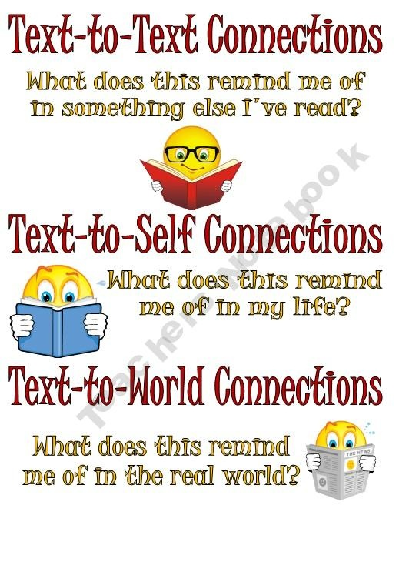
Click on image for video.

Slide 4
Text to Text
This reminds me of…
Other books
TV
Movies
Stories
Characters
These connections help me to better understand…
Events in the text because I can use background knowledge.

Slide 5
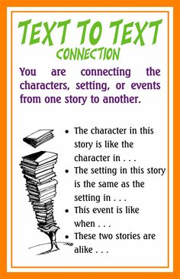
Making connections
When reading, you can make connections between the book and your life.
Connections include:
Text to text - connect the book to another book, story, or poem or even other events within the book.

Slide 6
Making connections
When reading, you can make connections between the book and another text.
Connections include:
Characters - how are characters alike
Settings - how are settings alike
Conflicts - how are conflicts alike
Themes - how are the themes alike

Slide 7
Text-to-text example with Thief and the Beanstalk
Example from text
The character of Finch is evil, greedy, and selfish. He is the leader of a vicious band of thieves who murder and steal from innocent victims. He is cruel and obsessed with getting revenge on anyone who betrays him.
Connection to another text - show how they are alike.
The character of Finch reminds me of the character of Voldemort in the Harry Potter series. Voldemort, like Finch, is evil. He heads a group of witches and wizards who terrorize and murder in the wizarding world. He is obsessed with getting revenge on Harry for destroying his power.

Slide 8
self example with Seventh-Grade Weirdo
Example from text
The character of The Shark is a mean, thoughtless, cruel bully who enjoys picking on those who are smaller and weaker than him. He is the leader of other kids who assist him in tormenting Rob.
Connection to another text - show how they are alike.
The character of The Shark reminds me of the character of Malfoy in the Harry Potter series. Malfoy, like The Shark, is a bully. Malfoy and his cronies bully Harry much like The Shark bullies Rob.

Slide 9
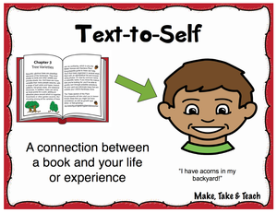
Text to Self
This reminds me of...
ME!
My life
My friends or family
My experiences
These connections help me to better understand…
Feelings and emotions of the characters in the text!

Slide 10
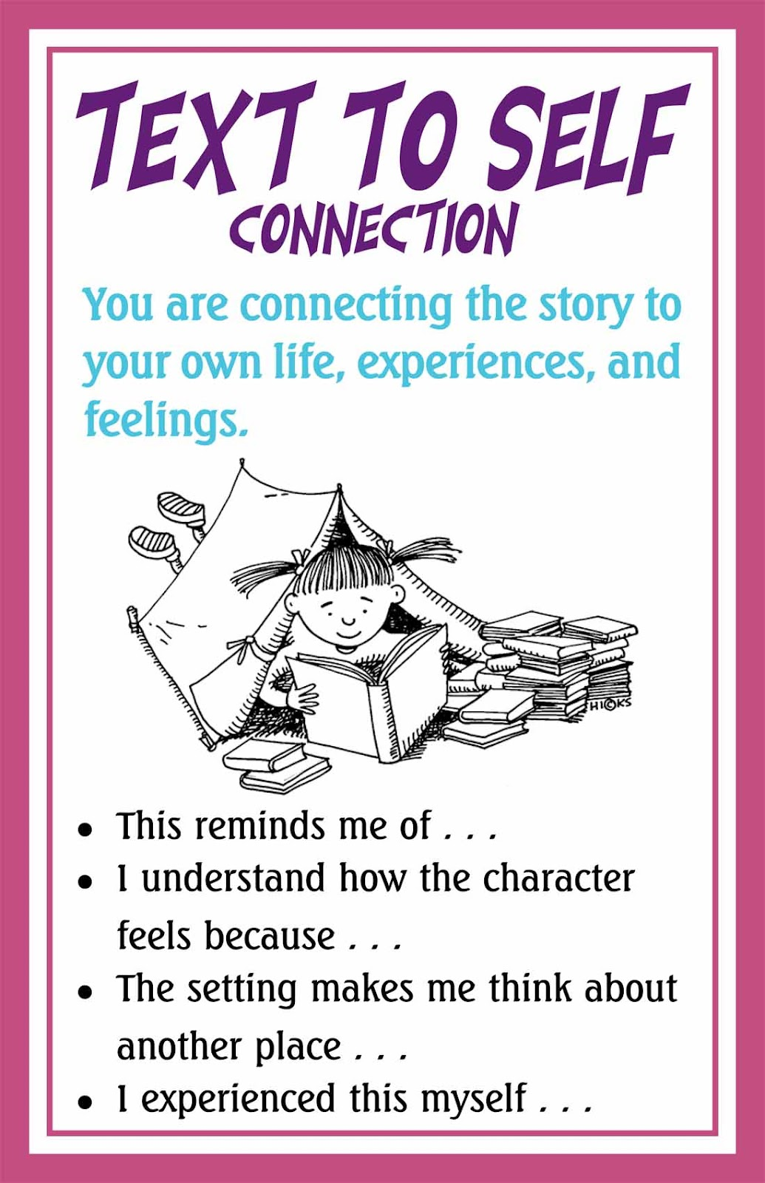
Making connections
When reading, you can make connections between the book and your life.
Connections include:
an event in the book like one in your life
A conflict in the book like one you have had
An emotion in the book that you have experienced,
A character in the book is like someone you know

Slide 11
Text-to-self example with Thief and the Beanstalk
Example from text
Jack is very sad and full of guilt for actions he has taken in the past. He regrets leaving Gullinda behind and thinks he may have caused her death. His remorse is a weight that he carries around every day of his life.
Connection to my own life - show how they are alike.
When I got in a fight with my friend, I said some mean things about her that weren't true. Like Jack, I felt horrible because I knew that I had hurt her and damaged our friendship. To this day I still feel guilty, and I wish I could take back my words and make better choices.

Slide 12
Text-to-self example with Seventh-Grade Weirdo
Example from text
Rob is really mean to his little sister and says some very hurtful things to her. He blames her for his problems and she embarasses him. He is selfish and thinks of himself and not of Winnie or her feelings.
Connection to myself - show how they are alike.
I can be very mean to my little brother. He embarasses me and when he does, I say hurtful things to him like Rob does to Winnie. I know that I am being selfish and petty when I do this. I can learn from Rob’s mistakes and love my little brother just the way he is.

Slide 13
Text to World
This reminds me of...
A historical event
Science
BIG issues/current events
People in general!
These connections help me to better understand…
The theme and author’s purpose of the text.

Slide 14
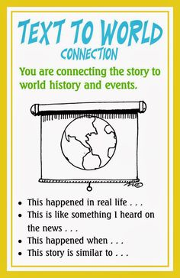
Making connections
When reading, you can make connections between the book and your life.
Connections include:
Real life situations
Current events/people
Historical events/people

Slide 15
Text-to-world example with Thief and the Beanstalk
Example from text
In the novel, one of the many themes is that goodness will be rewarded. Nick chooses to become an honest, caring boy rather than a sneaky, dishonest thief. Because of this choice, he is rewarded at the end of the story with a new family who love and care for him.
Connection to the world - show how they are alike.
Last year in France Mamoudou Gassama, a 22 year-old immigrant, climbed 4 stories to rescue a child hanging from a balcony. In addition to saving the child’s life, he was rewarded with French citizenship, and he was offered a job with the French fire department. Like Nick, his goodness was rewarded with a new home and a rewarding career.

Slide 16
Text-to-world example with Seventh-Grade Weirdo
Example from text
In the novel, Rob discovers that having no personal freedom leads to becoming trapped and restricted like the people of the Revolutionary War who were treated unfairly by England. And like the American colonists, you have to stand up for yourself as Rob stood up to The Shark.
Connection to the world - show how they are alike.
This reminds me of the Civil Rights Movement in America in the 1960’s. African Americans were treated so unjustly that they were limited in their opportunities. But like Rob and the colonists, they found the courage to stand up against unfair laws and treatment.

Slide 17
FLAT connections
DEEP connections
They’re nice, but don’t really help our “thinking.”
Flat connections are like telling stories...we enjoy hearing them but we don’t learn anything from them.
They help us to understand on a deeper level.
We use deep connections to understand:
How a character feels
Why something happened
How things fit together
What we think we will happen

Slide 18
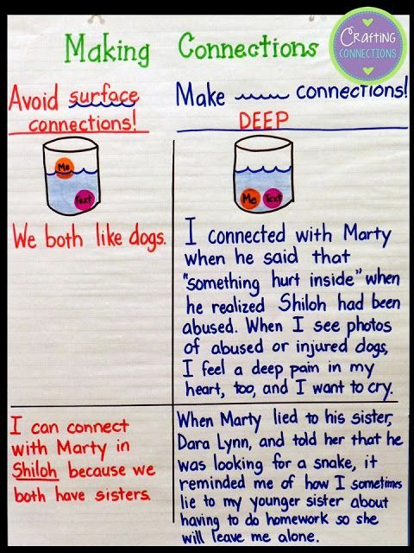
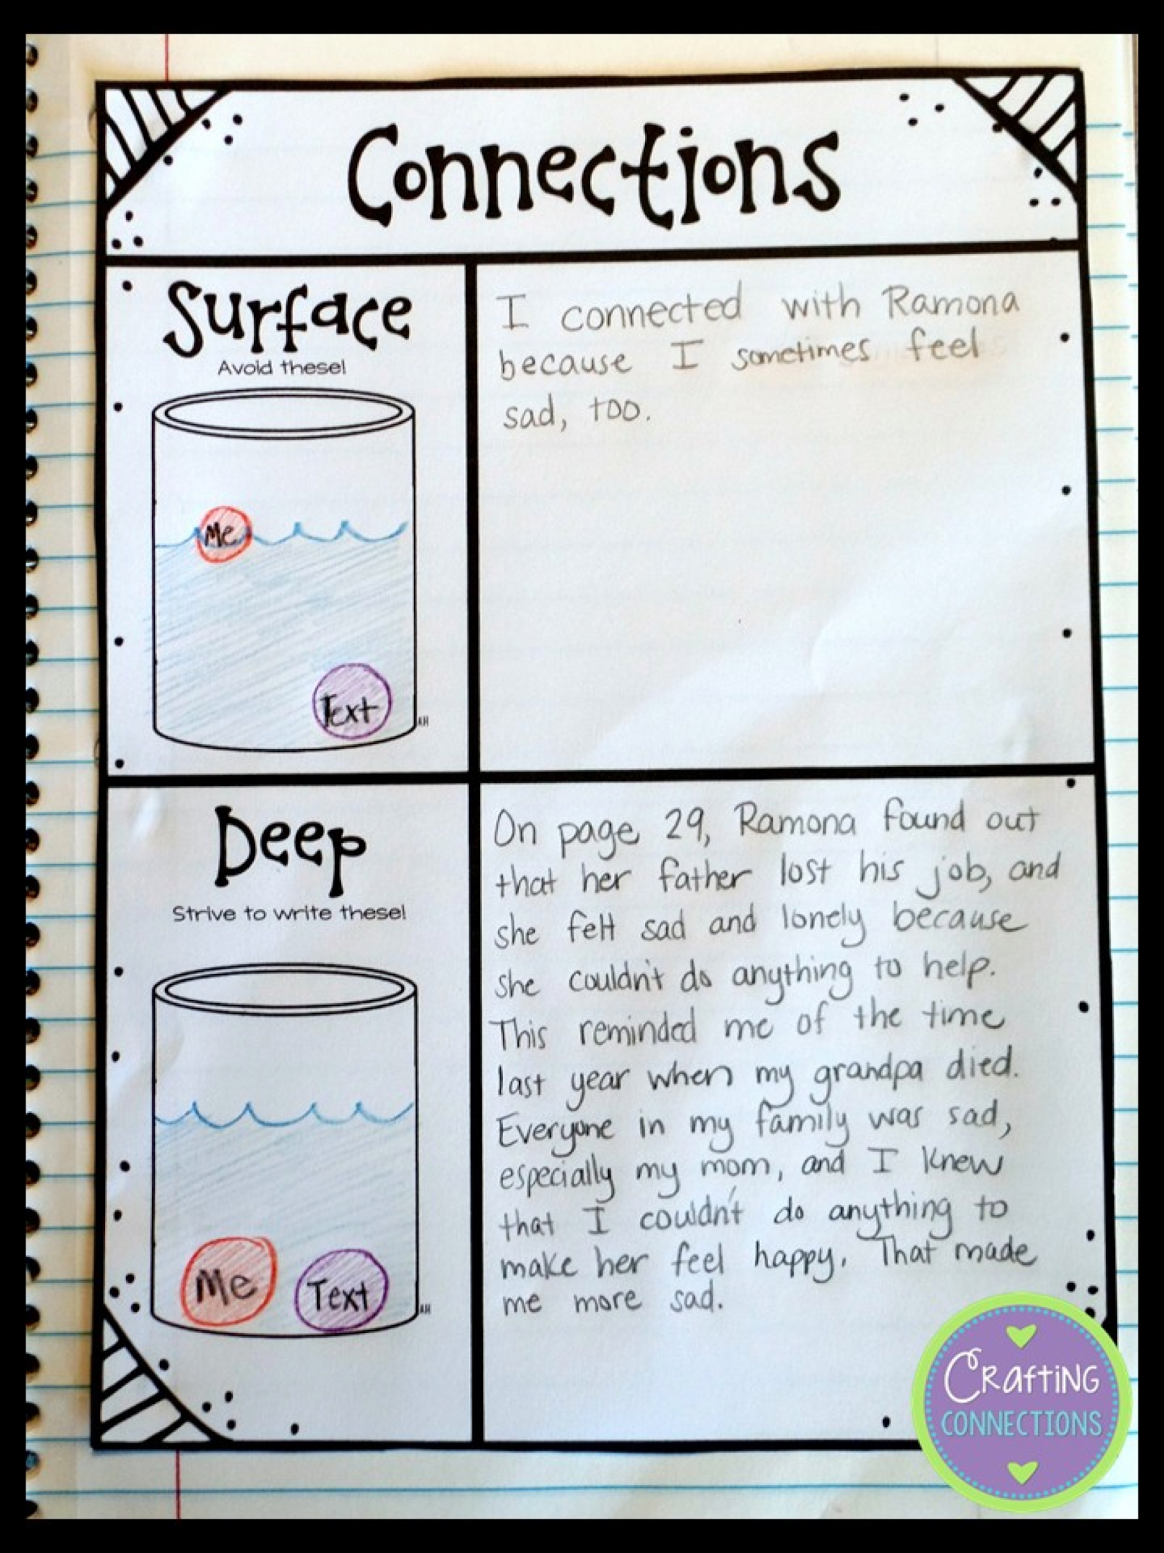
Making connections
When making connections, think deeply.
Avoid shallow, surface connections.

Slide 19
Making connections
When making connections, think DEEPLY. Avoid shallow, surface connections.
Shallow connections:
This character has a mom and I have a mom/dad/sister/dog, etc.
There is a disease and the book and there is disease in the world. (be specific)
There are mean people in the book and there are mean people in the world.
I like football and ___ likes football/ice cream/the color blue/cats, etc.
This book has chapters and ___ has chapters/pages/words/characters, etc.

Slide 20
Making connections
When making connections, think deeply.
To avoid shallow, surface connections, these sentence stems (starters) can help.

Slide 21
Practice making connections
On the left page, give an example from Thief or Seedfolks that you can relate to.
On the right, write at least two sentences explaining the connections you are making. Make DEEP connections.

Slide 22
Practice making connections
On the left page, give an example from Seventh-Grade Weirdo that you can relate to.
On the right, write at least two sentences explaining the connections you are making. Make DEEP connections.

