Slide 1
On Wednesday and Thursday of this week all 6th grade students will be taking a benchmark test on the iPad.
A benchmark test does NOT go in the gradebook. Its purpose is to see where your skills are at this time.
This benchmark test is called the MAP test, and it has replaced iStation that many of you have done in years past.
To be ready for this benchmark test, you need to download the app and take a short, sample test to get an idea of what to expect on testing days.
The directions to do this are on this power point.

Slide 2
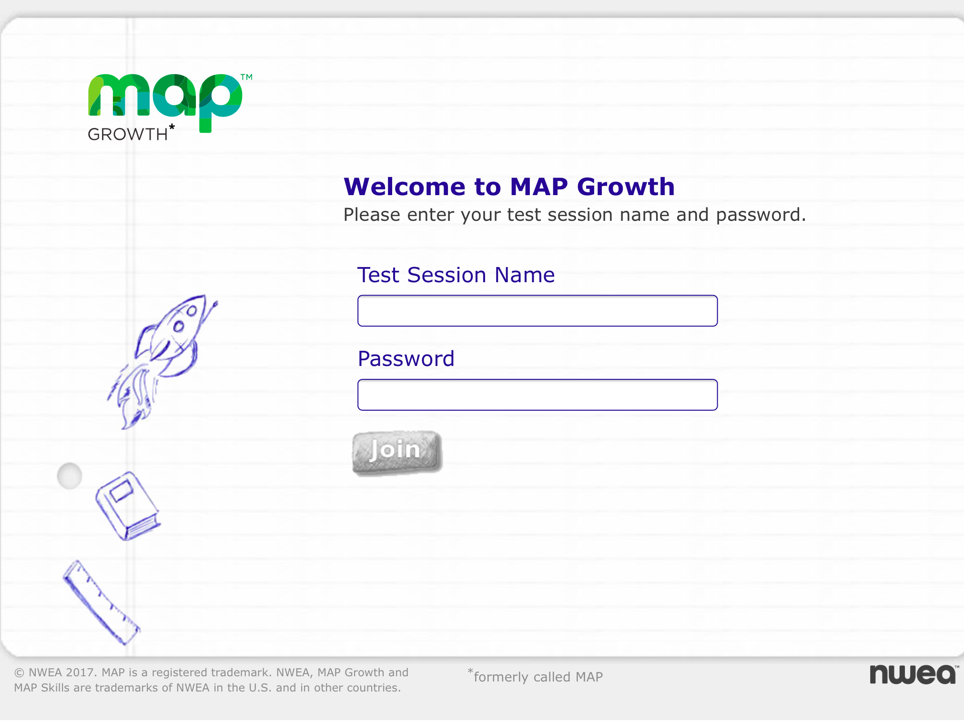
Targets:
Download the NWEA MAP app.
Try a sample test.
Know the two important items that you must bring to the test!
Testing Dates
September 27th - MATH September 28 - READING

Slide 3
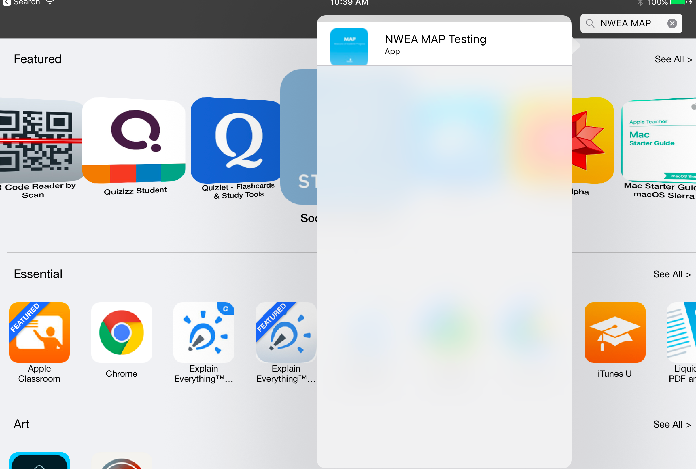
Go to Self Service, and download the NWEA MAP Testing app.
1-6
Notes:
MAP APP is on the students’ iPads

Slide 4
It will look like this on your iPad.
1-6
Notes:
MAP APP is on the students’ iPads

Slide 5
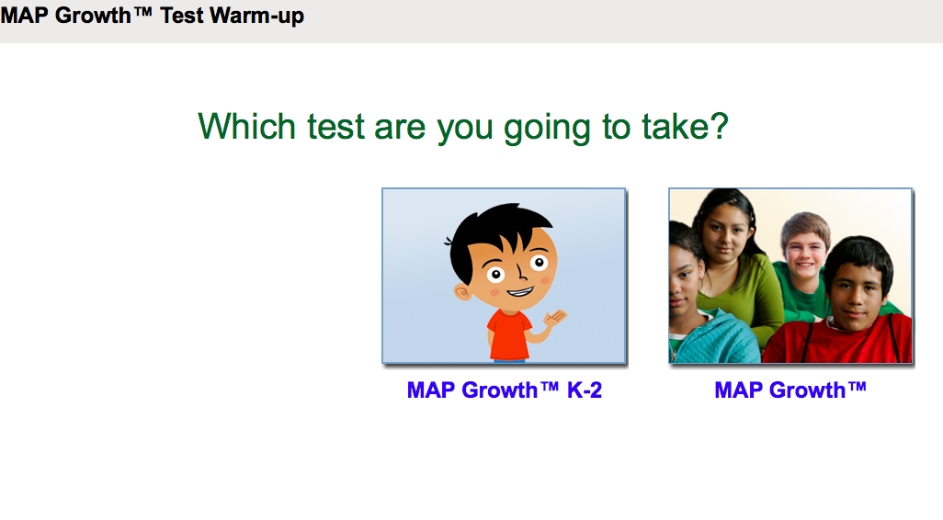
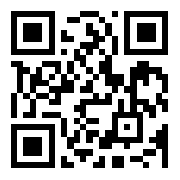
Now try a sample test! Use this QR Code to go to the MAP GROWTH grade 6+ questions in math, reading, and science!
TIP: Some questions will be easy, and others will be more difficult. You cannot get all the answers correct, but that is okay. If you really do not know the answer to a question, try to eliminate some answer choices, and then choose the best answer out of the remaining options.
What did YOU notice about the test?
Map Growth
Notes:
What do you notice about the test?

Slide 6
See the next slide if you have a pop-up blocker on!

Slide 7
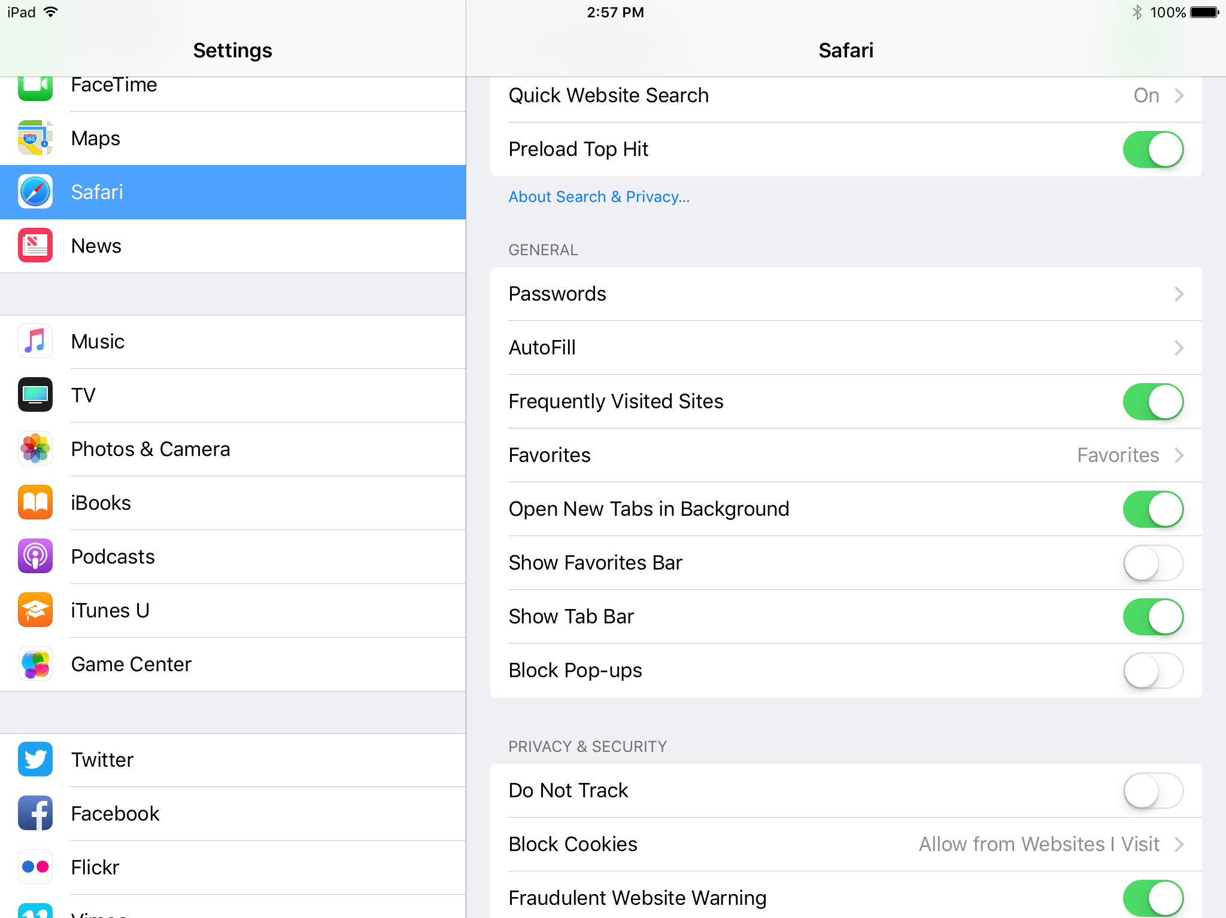
Turn- off. Should be white and not green.

Slide 8
ALL Students! You MUST bring these two important items before you can test on Wednesday and Thursday.
iPads must be fully charged.
2. A book

Slide 9
Friendly Reminder:
This Wednesday and Thursday, you will go to your second period teacher at the beginning of school when the first bell rings!
Testing Dates
September 27th - MATH September 28 - READING

