Slide 1
Theme
The moral of the story

Slide 2
What’s the “point” of reading a book?
Well, other than enjoyment or learning, authors also want us to walk away knowing the theme of their tale. It’s arguably the biggest way that books “speak” to us.

Slide 3
Authors usually want their novel to have an impact on the reader.
They often include a moral, message, takeaway, or THEME for the reader to “get out of” the book. But instead of lecturing (or telling) you their theme, authors SHOW their themes gradually, allowing readers to decide it for themselves.

Slide 4
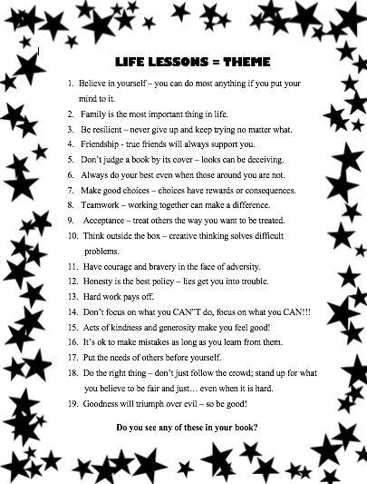
Theme is…
…the life lesson(s) the author wants the reader to learn and take away from the text.
Theme is a “truism” that you can apply to your own life.

Slide 5
THEME VS. TOPIC: There’s a big difference between them!
Topic: a one-word answer or vague concept. You can often turn a topic into a theme.
Theme: a phrase or sentence that specifically states an author’s belief on the topic.
Topic | Theme
Bravery | More people need to be brave in the face of adversity.
Acceptance | Treat others the way you want to be treated.
Change | Change is inevitable, and therefore it should not be avoided.
Friendship | Friendship is more important than personal gain.
Love | Love conquers all.

Slide 6
themes are hinted through characters’ words and actions.
Authors imply a theme in both what the protagonists AND antagonists do.
Example: When Katniss (the good guy) is repulsed by all the violence, we know the author is against it, too, and she wants us to dislike violence, like Katniss.
Example: When Voldemort (the bad guy) tries to live forever, we can infer many possible themes about immortality, what it means to be human, selfishness, etc
Example: When Jack lives his life with sadness and regret; we infer the theme that choices have consequences and that quilt is a life-long burden to be avoided.
Example: When Rob finally stops blaming Winnie for all his troubles, he realizes his mistakes and takes responsibility for his own actions and choices which leads to the theme of don’t blame others for your problems.

Slide 7
Pay attention to dialogue. Remember, the theme might only be IMPLIED; don’t panic if it’s not stated in super-obvious dialogue.
“You know lad, to a hungry man, a good cow is worth more than all the gold in the world. Can’t drink gold, now, can you?” (110). Greeneyes says this implying the theme that money is not everything.
Curtis says, “You don’t know what you got till it’s gone” (52) directly stating the theme that often people don’t appreciate the good things they have until they not longer have them.
Rob thinks, “He’s called me a weirdo, and I believed him. I’d made him more important than my own family. More important than myself” (147). This shows the theme of believing in yourself, not giving others power over you, and the importance of family.

Slide 8
Entire book & ending – what did the characters (and the reader) learn?
A writer may build theme SLOWLY over the course of the whole novel/text.
Most themes don’t only appear once. The author inserts several moments of action and dialogue, and the PATTERN or REPETITION of the concept is how you know it’s a theme.
How many times did Jack talk about his guilt?
Often, themes are reinforced in the ending, during the plot’s climax and/or resolution (which as when they’re reflecting on what just happened).
At the end of the SGW, the author made the theme very clear: “I’ll never have a normal, ordinary family. But then, what’s wrong with being extraordinary? Jenner made me realize that” (149).
At the end of Thief, good clearly defeats evil.

Slide 9
More than one theme is possible (and they’re also debatable!)
Most long texts – like a novel – will have more than one theme.
(Think of Harry Potter! Would you limit that book to just ONE theme when it clearly talks about friendship, bravery, loyalty, and other topics too?)
You and your friends might disagree on what the biggest theme is, or if a certain theme is present. That’s ok…as long as you can prove it!!!
Notice how all the earlier examples of theme had text evidence to support it.

Slide 10
Evidence must back up your theme.
You can’t randomly declare a theme that doesn’t have proof -- or text evidence – to support your theme.
There has to be a reason why you think a particular theme is present in your story. Use PEEL to prove your theme.
A theme in Thief is face your fears. In Ch. 12, Jack sends Henry to spy on the thieves. Jack knows that Henry is scared, but Jack tells him, “Better to face you fears sooner than later” (132). Then, when Henry sneaks up on the gang, he discovers that, “…his fear had almost vanished” (134). Jack forced Henry to do this thing that scared him, and when he did, the fear went away. Clearly the theme – or lesson – is to face your fears.
point
evidence
explain the evidence
link back to the point

Slide 11
Evidence must back up your theme.
You can’t randomly declare a theme that doesn’t have proof -- or text evidence – to support your theme.
There has to be a reason why you think a particular theme is present in your story. Use PEEL to prove your theme.
One theme – or lesson – in SGW is not to worry about what other people think. At the end of the book, Rob accepts that his family is different and finally realizes that, ”It doesn’t matter if the kids at school think we’re weirdos. It only matters what I think”(149). This means that Rob has learned that other’s opinions don’t matter, only his opinion is important. Therefore, don’t put more importance on what other people think than on what you believe is a theme in the book.
point
evidence
explain the evidence
link back to the point

Slide 12
Your turn!
What are some themes in your book? What do you think the author wants the reader to learn from the story?
Remember:
Think about the character’s words and actions.
Pay attention to repeated ideas, words, actions, etc.
Look closely at the ending of the book – often themes are reinforced there.
What did the characters learn? That is usually what the author wants you to learn as well.

